Slide 1
Test Driven Development
Applied to
Database Object Refactoring
KROLL BOND RATING AGENCY, INC

Slide 2
Agenda
Introduction
Refactor a database object using a Test Driven Development methodology
The object is a CASE expression in a Transact-SQL query
SQL Features
CASE - expression
CTE – common table expression
VALUES - constructor
WHILE - loop
Business Terms
Delinquency Status
Foreclosure
Default
Tools Used
Microsoft SQL Server Management Studio (SSMS) - Query Analyzer

Slide 3
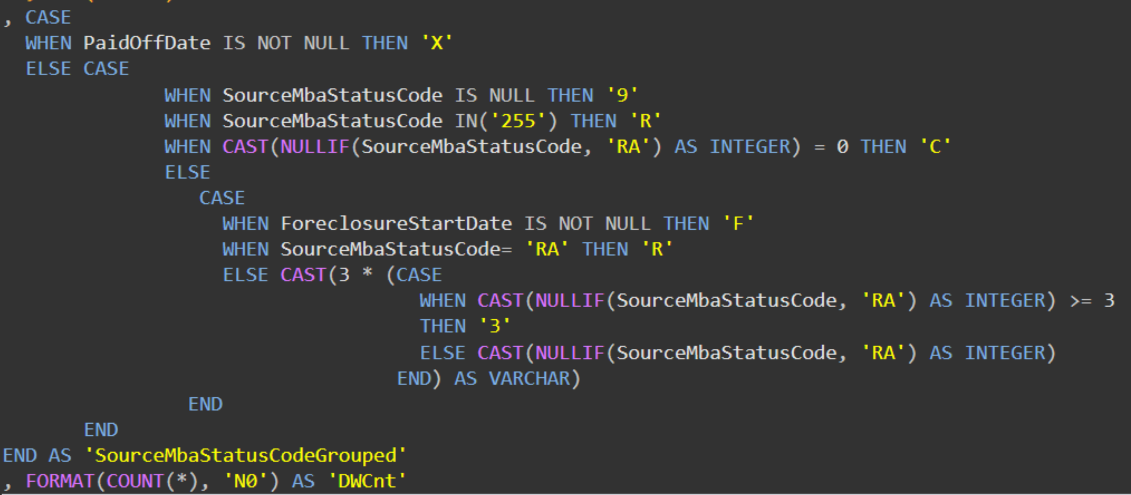
CASE expression
Notes:
As the column name implies the CASE statement is also in the GROUP BY clause

Slide 4
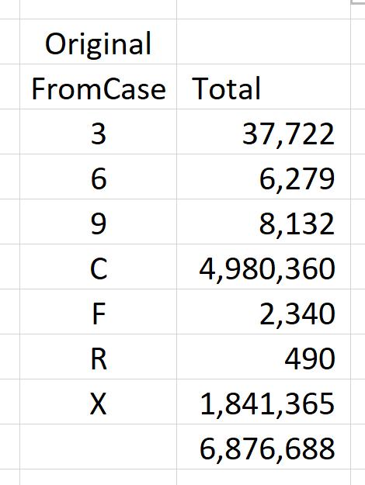
CASE expression - output from the Query
Notes:
You might guess from the gridlines that this is from Excel

Slide 5
CASE expression – elements of complexity
Case 1
Case 2
Cast to int
NullIf
Case 3
Case 4
Multiply
Cast back
Notes:
As the column name implies the CASE statement is also in the GROUP BY clause

Slide 6
Identify Test Cases
Notes:
First element PaidOffDate – null or not
Second element ForeclosureStartDate – null or not
other than those two we need all the SourceMbaStatusCode – its values get examined and/or operated on.

Slide 7
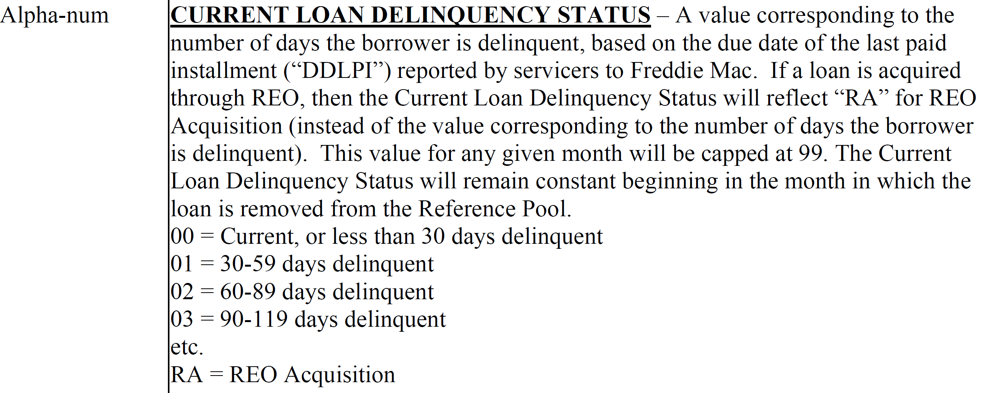
Identify Test Cases
Notes:
First element PaidOffDate – null or not
Second element ForeclosureStartDate – null or not
other than those two we need all the SourceMbaStatusCode – its values get examined and/or operated on.

Slide 8
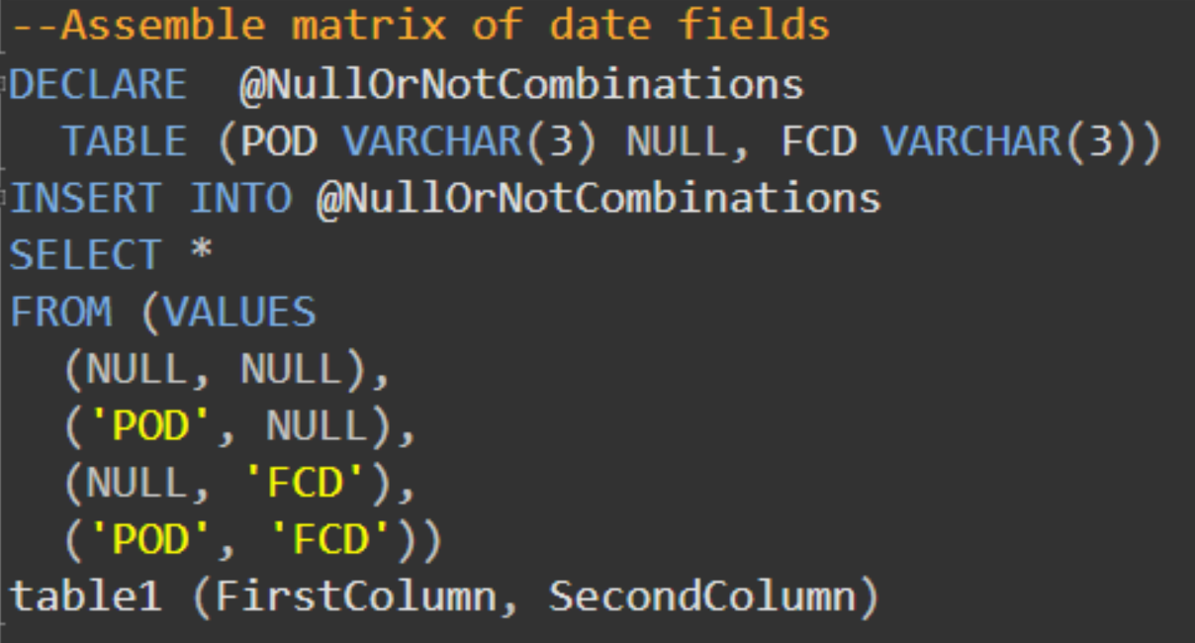
Build Test Cases
Notes:
How do we get all the test cases?
With a CASE expression.
Chugging thru this large table takes a long time.

Slide 9
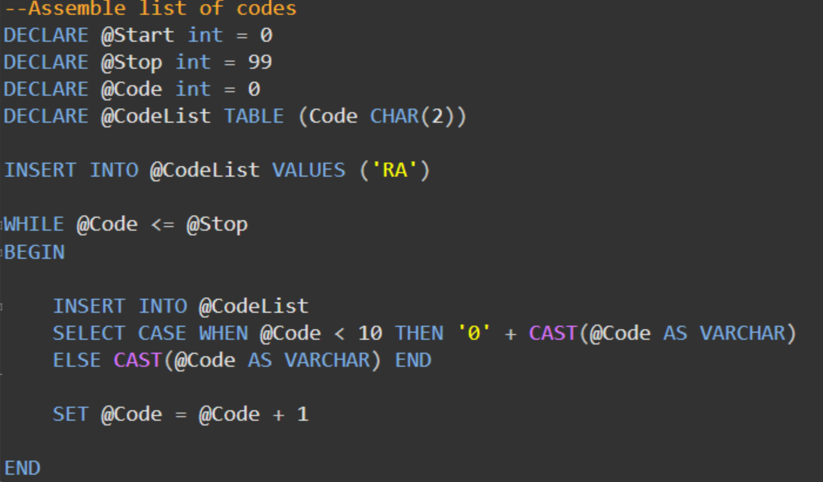
Build Test Cases
Notes:
How do we get all the test cases?
With a CASE expression.
Chugging thru this large table takes a long time.

Slide 10
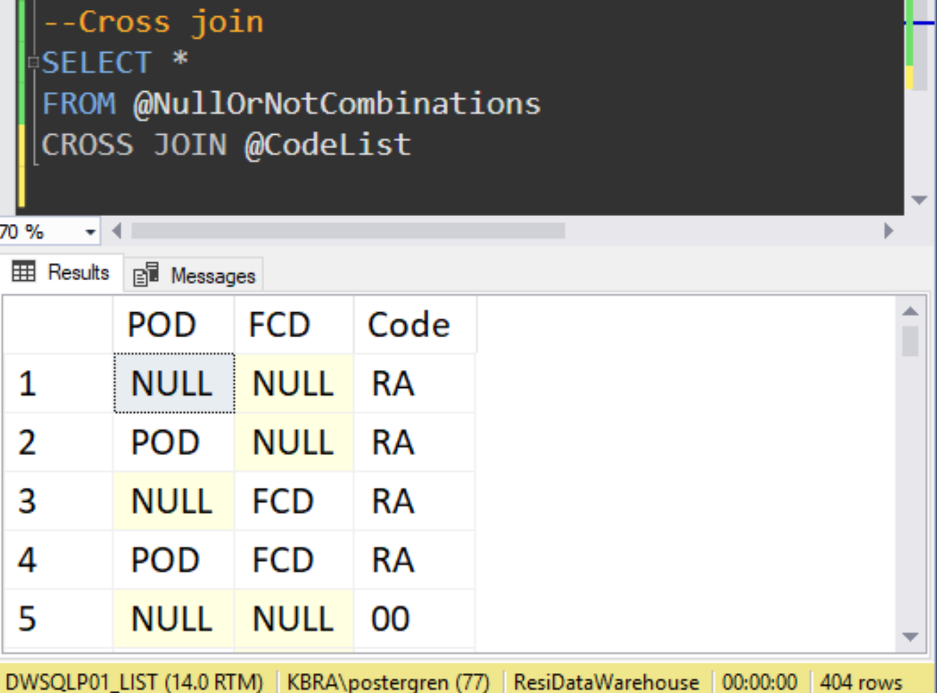
Build Test Cases
Notes:
How do we get all the test cases?
With a CASE expression.
Chugging thru this large table takes a long time.

Slide 11
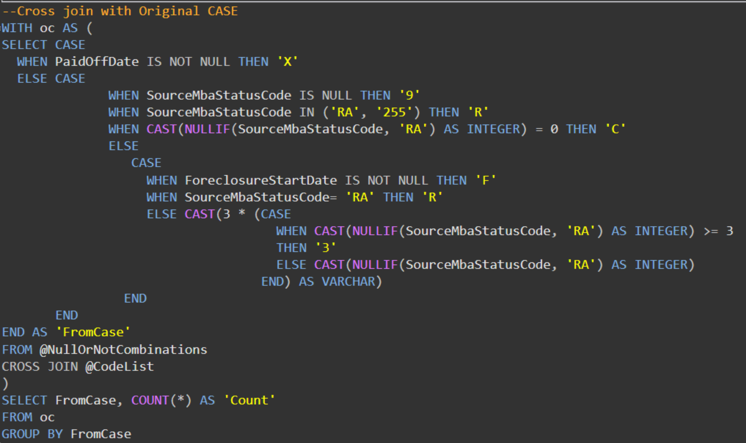
Run Test on Original code
Notes:
How do we get all the test cases?
With a CASE expression.
Chugging thru this large table takes a long time.

Slide 12
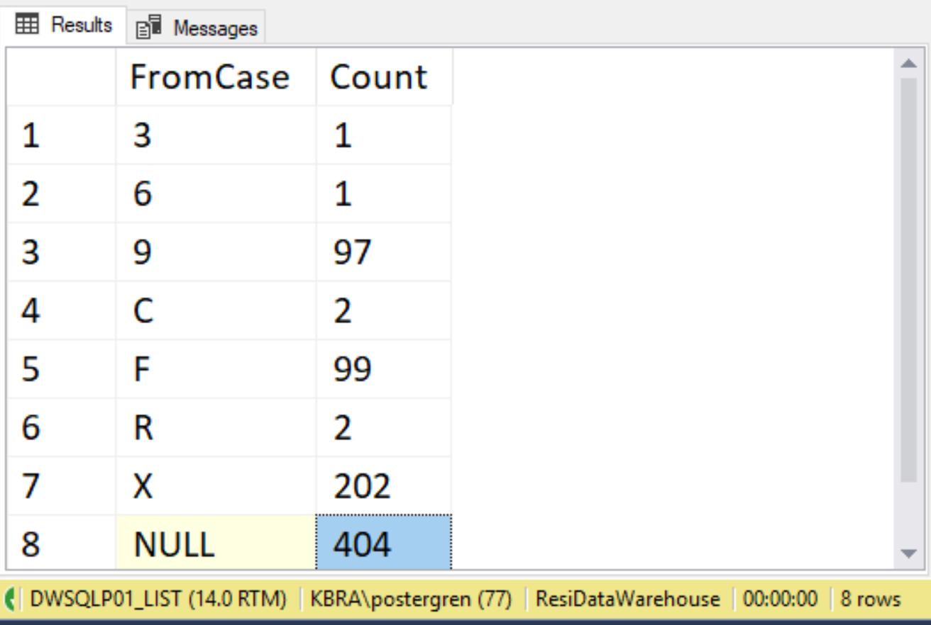
Establish baseline on Original code

Slide 13
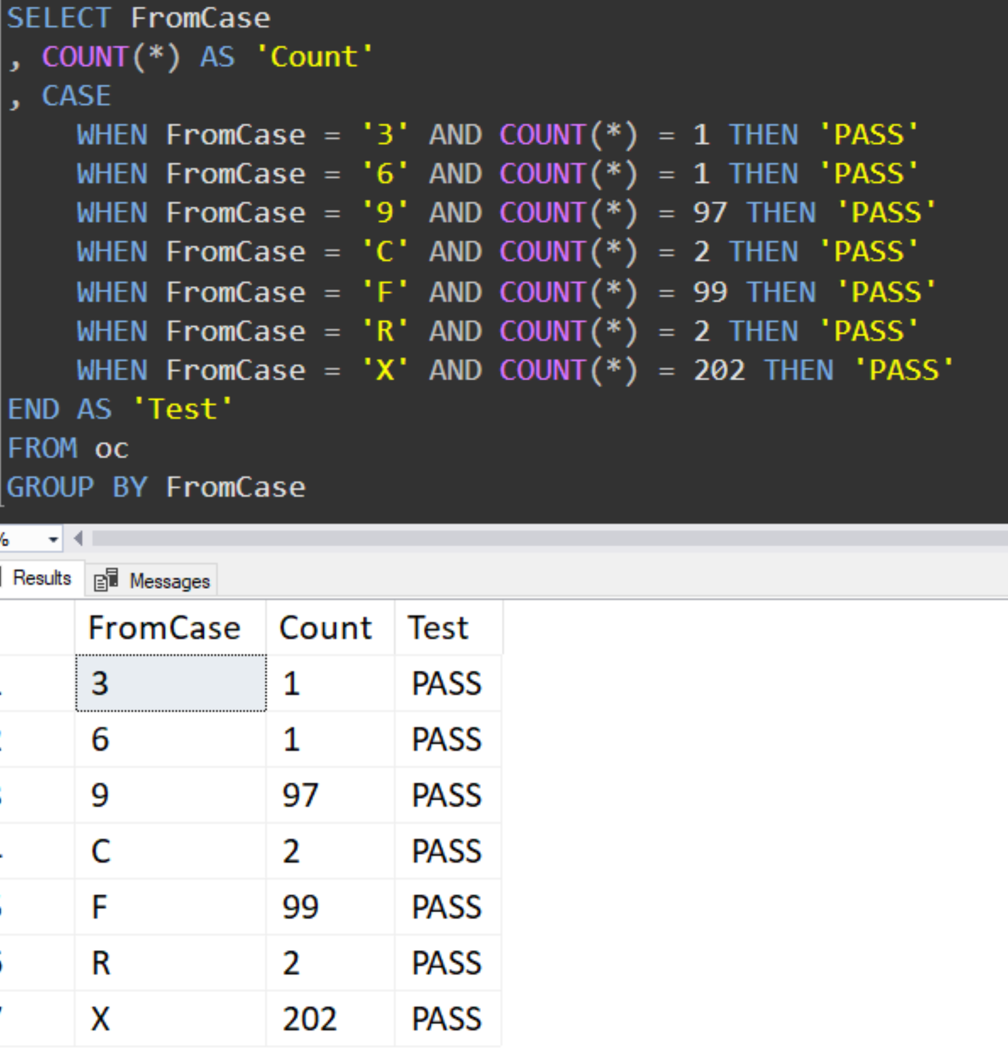
Test changes against baseline

Slide 14
Test changes against baseline

Slide 15
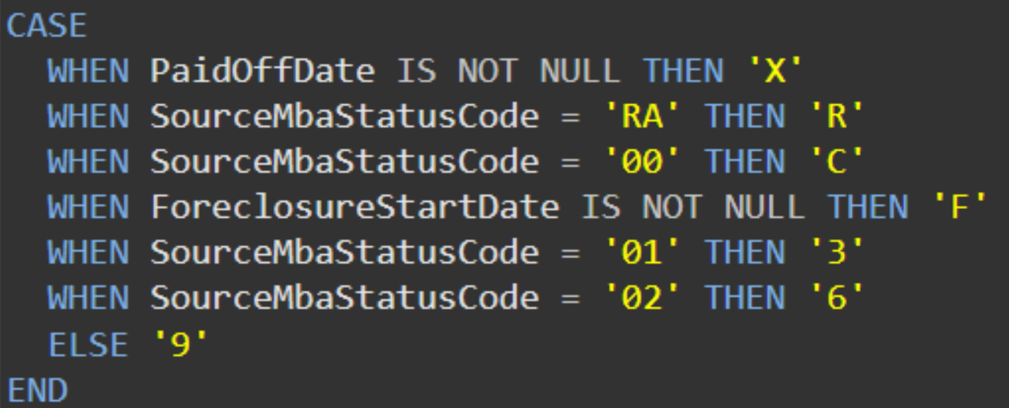
Final Result

